Slide 1
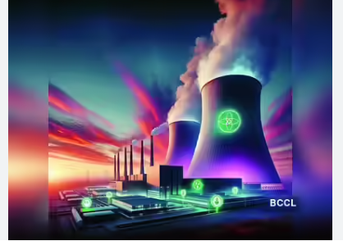
Team Watt Agents Real-time resilience Approach
PRIPYAT-1986- AN AI Take
Team Watt agents
Shruti Kate
Amar Shikhar
V, Sreenivas
Deendayal an Balaji
M, Navenaa
Shaji, Vaishak

Slide 2
WHAT
WHY
Business Challenges
Use Case Description
KPIs Impacted
PRIPYAT-1986 replays the Chernobyl disaster (April 25–26, 1986) through a 5-agent Azure OpenAI system that monitors live reactor telemetry, detects compound safety violations, and issues automated shutdown and evacuation orders — decisions operators refused to make. Main goal: prove agentic AI prevents catastrophic industrial failure. Key stakeholders: plant operators, IAEA regulators, emergency coordinators, and 49,000 civilian residents of Pripyat.
Current nuclear safety systems rely entirely on human judgment under extreme cognitive pressure.
Operators suffer confirmation bias (the "Dyatlov Effect"), have no real-time compound-risk detection across simultaneous failure modes (xenon poisoning + rod withdrawal + ECCS bypass), face 35+ hour evacuation delays due to chain-of-command paralysis, and lack any AI decision-support layer between raw sensor alerts and irreversible human action.
PRIPYAT-1986 streams 16 INSAG-7 declassified reactor events interpolated to 1-second ticks at 60× speed. Triggers: reactor power drops below 200 MW → xenon poisoning detected → control rods fall below safe minimum of 30 → ECCS manually bypassed → AI risk score crosses threshold 85 → mandatory AZ-5 SCRAM issued. AI acts 38 minutes before the actual explosion and orders evacuation 35 hours ahead of the Soviet government.
38 mins Earlier Emergency
Shutdown (vs. actual explosion at 01:23:40)
-35 hours Earlier Civilian Evacuation
(vs. actual April 27, 14:00 order)
-100% Safety Protocol Compliance Rate
(vs. 0% on April 26, 1986)
<$0.10 Cost Per Full Simulation
Run on Azure OpenAI
Business Impact
Deploying agentic AI as a safety co-pilot in nuclear and critical infrastructure plants eliminates operator cognitive bias from life-or-death decisions.
The guardrail-first + LLM-blend architecture is immediately reusable across oil & gas, aviation, and pharma. Enterprise value: automated regulatory compliance,
real-time compound-risk scoring, MCP-compatible agent modules, and a single USE_AZURE=true flag for full Azure deployment.
HOW
WHO
Functional Solution
Technical Solution
Stakeholders
> Real-time monitoring of 11 reactor parameters via SensorAgent. AI risk scoring via RiskAgent (70% Azure OpenAI GPT-4o + 30% rule-based formula). Automated 5-level decision ladder: CONTINUE → WARN → ABORT TEST → SCRAM → EVACUATE. Gaussian plume radiation broadcast to IAEA, WHO, Belarus at 5–300 km. Evacuation logistics engine: 49,000 residents, 1,200 buses, 3 escape routes, auto-calculated trip counts and hours.
> 7-layer Python architecture (asyncio, FastAPI, Rich, OpenAI SDK). Azure Event Hubs streams telemetry → Azure OpenAI GPT-4o (structured JSON schema outputs) → Cosmos DB (state history) → Azure AI Search (IAEA RAG) → React on AKS (live web dashboard). Hard guardrails are non-negotiable; LLM advisory layer blended at 70%. Full pipeline validated via `--smoke-test` in 5 ticks. Single `USE_AZURE=true` flag activates full Azure stack.
- Nuclear plant operators & shift supervisors (primary users)
- IAEA / national nuclear regulatory authorities
- Civil emergency coordinators & evacuation planners
- Civilian populations in plant exclusion zones (49,000+ in Pripyat model)
- Capgemini & Microsoft Azure enterprise clients (reusability across industries)

Slide 3
PRIPYAT-1986 — USE CASE & ARCHITECTURE
Preventing the Chernobyl Disaster with a 5-Agent AI System on Azure
PRIPYAT
Real-time resilience Approach
This use case is Morden day take on the 1986 Chernobyl disaster. How a multi agent AI system could control and rescue this kind of situation today.
Use case details:
1986 replays the real Chernobyl nuclear disaster (April 25–26, 1986) through a 5-agent Azure OpenAI-powered system that makes every decision Dyatlov refused to make — proving that agentic AI can prevent catastrophic failure in safety-critical industries.
Built on 16 INSAG-7 declassified reactor events, the system demonstrates that a responsible multi-agent architecture — combining hard safety guardrails with LLM reasoning
Detects compound risks, triggers emergency shutdown **38 minutes before the actual explosion**, and orders evacuation **35 hours earlier** than the Soviet government did.
Complete Agentic AI solution build upon Microsoft AI tech stack which will act as control mechanism in High-risk power plant systems which can used in Energies and Utility sector

Slide 4
Usecase — Real-time resilience Approach
Preventing the Chernobyl Disaster with a 5-Agent AI System on Azure
Problem
Human operators under stress make biased, life‑critical decisions. Past failures (e.g., Chernobyl) caused mass casualties, displacement, and enormous economic loss. Goal: Eliminate the “Dyatlov Effect” with objective, real‑time AI safety oversight.
Who Benefits
Plant Safety Officers – instant risk scoring, unbiased shutdown validation
IAEA Regulators – transparent, audit‑ready logs
Emergency Coordinators – early, accurate alerts for evacuation
Local Residents – significantly earlier protective action
What’s New (Innovation)
First multi‑agent model using INSAG‑7 telemetry
Novel guardrail‑first + LLM blended scoring (70% AI / 30% rules)
Detects compound risks no single threshold can catch
Why AI Fits
LLM reasoning identifies converging failures (e.g., xenon poisoning + rod withdrawal + ECCS bypass) and delivers millisecond‑level risk evaluation.

Slide 5
Usecase — Real-time resilience Approach
Preventing the Chernobyl Disaster with a 5-Agent AI System on Azure
Safeguards
Risk > 85 → mandatory SCRAM (non‑negotiable)
LLM cannot override safety rules
Anti‑hallucination logic blocks false shutdowns
Ready Today
Fully operational in Python (asyncio, FastAPI, Rich)
Runs 60× accelerated simulation in ~15 min
Quick demo via --smoke-test
Scale & Reuse
Azure‑ready (Event Hubs, Cosmos DB, AKS)
Add new reactors via timeline config
Agents reusable for oil & gas, aviation, pharma, and other safety‑critical domains
Impact
AI SCRAM: 38 minutes earlier
AI Evacuation: 35 hours earlier
Real‑time plume model for 5–300 km range

Slide 6
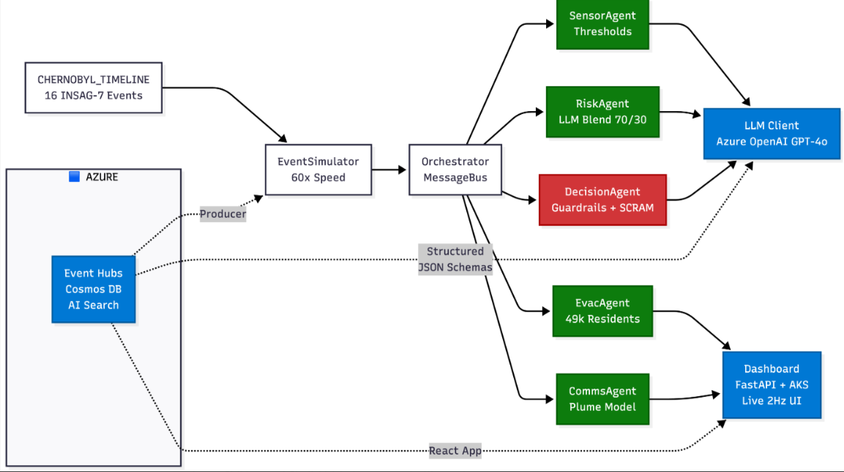
Functional Architecture

Slide 7

High Level Technical Architecture
Real-time resilience Approach
Orchestrator
Source
Technologies
Agents
Evac Agent
Sensor Agent
All Data
Decision Agent
IOT Data
Copilot Studio
Microsoft Foundry
GPT-4.1-mini
Azure Event Hubs
Azure Service Bus
Azure Cosmos DB
React on AKS
Fast API
Azure ADLS
Risk Data
Risk Agent
Comms
Agent
Human in the loop (Overwrite)
Monitoring & Insights | Governance & Compliance | Memory & Optimisation

Slide 8
ARCHITECTURE - Real-time resilience Approach
Preventing the Chernobyl Disaster with a 5-Agent AI System on Azure
Clear Architecture Flow— 7 named layers (`timeline_data → simulator → config → llm_client → agents → orchestrator → UI`); every tick follows a deterministic 6-step pipeline: Sensor → Risk → Decision → Evacuation → Comms → Dashboard
Platform Fit— Azure Event Hubs (telemetry streaming), Azure OpenAI (structured JSON outputs), Cosmos DB (state + history), Azure AI Search (IAEA doc RAG), AKS (web dashboard) — each service matched precisely to its workload characteristic
Data & Governance — 16 INSAG-7 events stored as typed `ReactorState` dataclasses; all LLM outputs use JSON Schema (`RISK_ASSESSMENT_SCHEMA`, `DECISION_SCHEMA`) for guaranteed schema compliance; full tick history exported to `final_report.json`
Security — API keys via environment variables exclusively; LLM influence is advisory-only and cannot override hard guardrails; anti-hallucination guard isolates LLM from triggering safety actions below risk threshold 40; no sensitive telemetry persisted in logs
Reliability — Every LLM call has a 5-second timeout + graceful degradation: returns `None` on failure → agents instantly fall back to deterministic rule logic; simulation continues at full cadence with zero LLM dependency at runtime

Slide 9
ARCHITECTURE - Real-time resilience Approach
Preventing the Chernobyl Disaster with a 5-Agent AI System on Azure
6. Performance — 60x simulation speed (1 real minute = 1 simulated hour); LLM capped at 5s timeout; dashboard at 2Hz refresh; `avg_latency_ms` tracked live per `LLMClient`; EventSimulator interpolates 16 events into smooth per-second ticks
7. Cost Awareness — LLM called only at 5 key decision points + threshold crossings, not every tick; 3 of 5 agents are fully deterministic (zero API cost); estimated cost per full simulation run: < $0.10; Azure Pricing Calculator compatible
8. Calability — Azure Event Hubs supports millions of events/sec; adding Reactor #3 monitoring requires only a new `CHERNOBYL_TIMELINE` config; pub/sub `MessageBus` decouples all agents for independent horizontal scaling on AKS
Integration — In-memory `MessageBus` connects all 5 agents; Orchestrator aggregates outputs into a unified `tick_summary` dict; FastAPI `/events` SSE endpoint streams live simulation data to the browser dashboard; all Azure services connected via documented SDK clients
Provisioning Readiness — All Azure equivalents inline-documented per module; `requirements.txt` covers all dependencies; `--smoke-test` mode validates the full 5-agent pipeline in 5 ticks; deploy-ready via `python main.py --web --port 8000` with a single-flag Azure toggle

Slide 10
Thank YOU

Slide 11
Appendix

Slide 12
Architecture
Preventing the Chernobyl Disaster with a 5-Agent AI System on Azure
PR 7-layer architecture maps natively to Azure:
EventSimulator→ Azure Event Hubs**,
MessageBus → **Azure Service Bus**,
Orchestrator state → **Azure Cosmos DB**, `
LLMClient → **Azure OpenAI GPT-4o**, `
RiskAgent` knowledge retrieval →
Azure AI Search** over IAEA docs
Web dashboard → **React on AKS** — each choice aligned with the Well-Architected Framework pillars of reliability, security, performance, and cost optimization. [www-pub.iaea](https://www-pub.iaea.org/MTCD/Publications/PubDetAR.asp?pubId=3786)
A detailed Architecture diagram is present on slide no.

